Slide 1




////////////////////////////
Analyze the Relationship Between Direct Marketing Campaigns And Subscribing Term Deposit
ISE 535 FINAL PROJECT
Group 11：Boyue Wang / Yu Yun Tsai / Yuqing Shi / Zizhen Qin
////////////////////////////
Notes:
Hi every one, our group project is analyze the realtionship between direct marketing campagins and subcribing term deposit

Slide 2


1
PART ONE
Project Summary
and objective
Notes:
First we will introduce our project summary and objective

Slide 3
Project summary and objective
Research Question
Our interest lies in direct marketing campaigns. We want to know the effectiveness of the direct marketing campaigns, and whether a customer would subscribe to a term deposit through a direct marketing campaign. Also, we want to predict after how many marketing campaigns, the customer would subscribe a term deposit. Moreover, we want to learn whether other attributes like, job, age, balance and loan would affect the result of subscribing a marketing campaigns.
Project Objective
Build models to predict whether a customer would subscribe a term deposit or not. After, we build the model and find a pattern for customer who have more possibility to subscribe a term deposit. The bank can put more human resources on the target customers instead of making worthless effort. Help the bank to increase the marketing campaign's successful rate.
Notes:
We want to know the effectiveness of the direct marketing campaigns , and we want to have a basic prediction of our user portrait and help the company maximum flexibility and efficiency in the use of human resources.

Slide 4
Dataset Summary
7 Numeric variables:
Age/Balance/Duration/Campaign/pdays/previous/day
9 Categorical variables:
Job/marital/education/default/housing/loan/contact/month/poutcome
Output variables
y – whether the customer subscribe or not.
Notes:
The data we use is from a direct marketing campaigns of a Portuguese banking institution. The data we use have more than 40,000 observations. We have 7 numeric variabals and 9 categorical variables. The outcome variable is whether the customer subscribe a term deposit or not.
# Dataset summmary
The data is related to direct marketing campaigns (phone calls) of a Portuguese banking institution. It consists of 41188 observations with 16 attributes including bank clients data, data related with the last contact of the current campaign, social and economic context attributes and other attributes.
## Input variables
### 7 Numeric variables:
age: the customers age
balance: the balance of the customers
duration: last contact duration, in seconds.
campaign: number of contacts performed during this campaign and for this client.
pdays: number of days that passed by after the client was last contacted from a previous campaign(-1 means client was not previously contacted)
previous: number of contacts performed before this campaign and for this client
day: last contact day of the month
### 9 Categorical variables:
job : type of job
marital: marital status
education: education level
default: has credit in default?
housing: has a housing loan?
loan: has a personal loan?
contact: contact communication type
month: last contact month of year
poutcome: outcome of the previous marketing campaign

Slide 5
2
PART TWO
Univariate Analysis

Slide 6
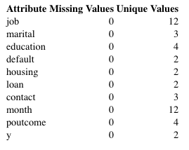
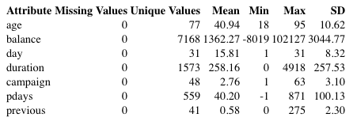
Summary table
Numeric Attributes
Categorical Attributes
Notes:
The first thing we do is to see whether the data is clean. From the summary of the univariate analysis we find that both nuimeric and categorical attributes is clean. There is no missing values and all of the attributes have more than 2 unique values.

Slide 7
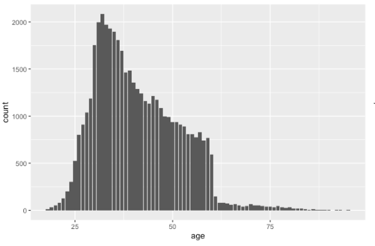
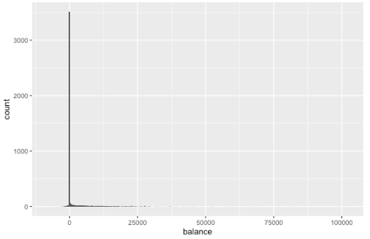
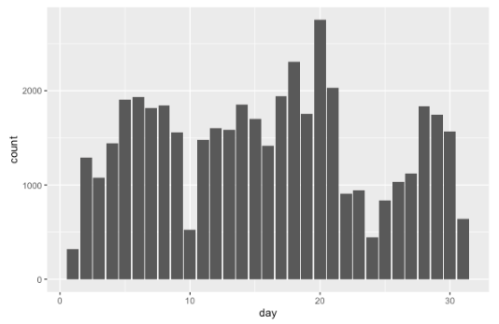
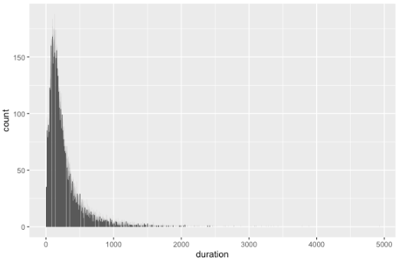
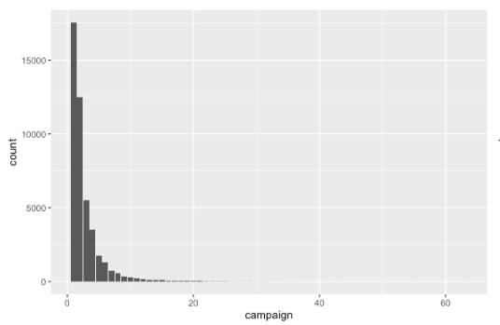
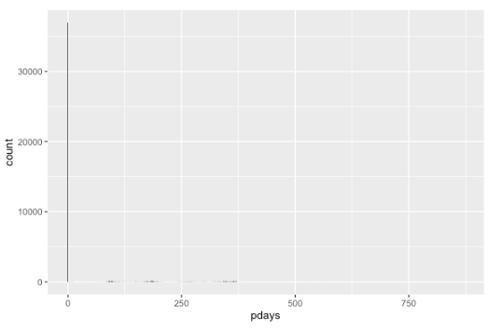
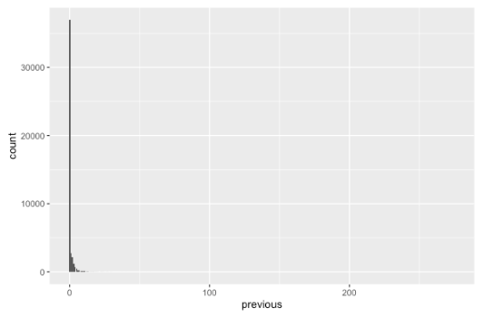
Numeric
Visualization
Age
Balance
Day
Duration
Campaign
pdays
Previous
Notes:
From the visualization, we find that the plot of balance pdays and previous is quite focus. pday is number of days that passed by after the client was last contacted from a previous campaign and previous is number of contacts performed before this campaign. In this way we find that if the customer is a new customer the pdays and previous will have the same record. And the new customers are more than 30,000. So we decided to seperate the data.

Slide 8
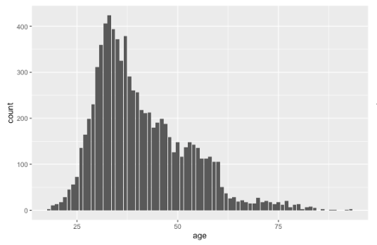
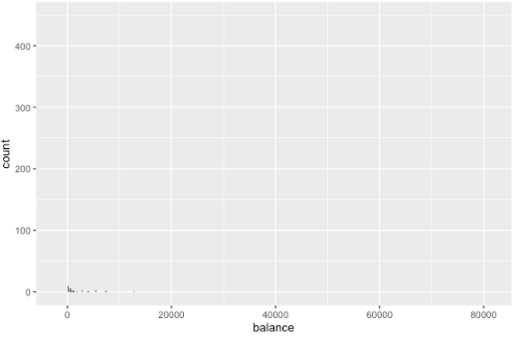
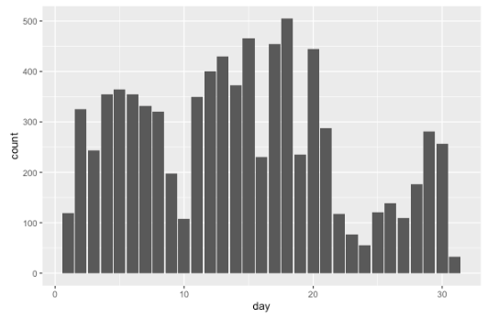
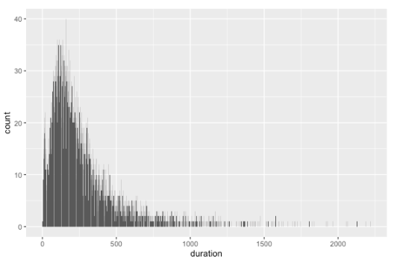
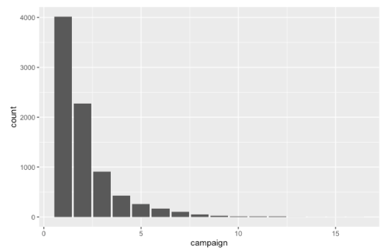
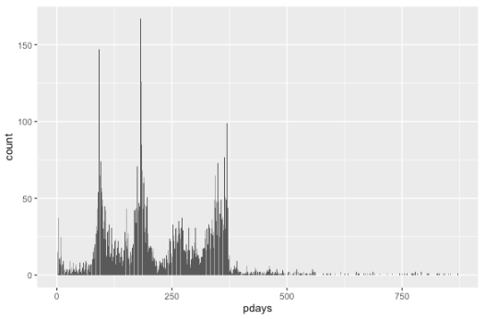
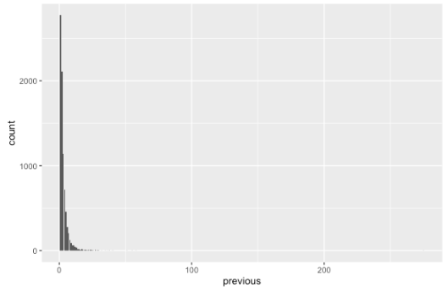
Numeric
Visualization for
old customers
Age
Balance
Day
Duration
Campaign
pdays
Previous
Notes:
Although there is not a big difference in the balance and previous, the pdays has some changes.

Slide 9
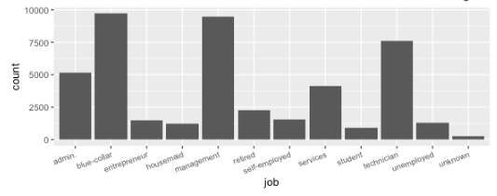
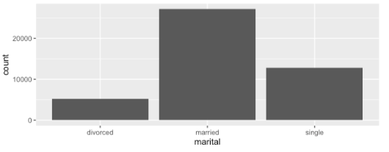
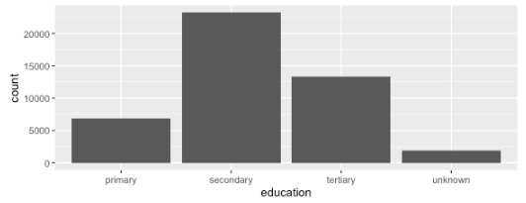
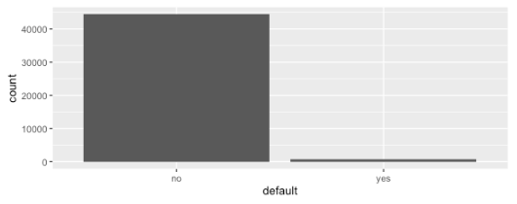
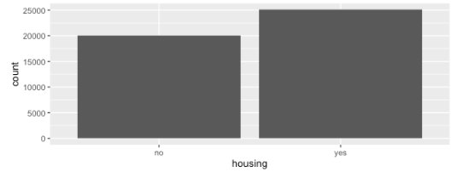
Categorical
Visualization
Job
Marital
Education
Default
Housing
Notes:
Most customers are blue-collar Management and Technician. More over most usual contacy way is cellular.
For the categorical attribute we find that our customer focus on blue-collar, management and technician. The education level is focused on secondary. Also, most our customers are married.

Slide 10
3
PART THREE
Bivariate Analysis

Slide 11
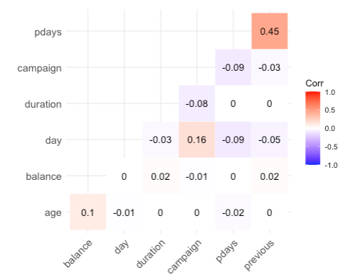
Correlation Matrix
From the correlation matrix, we find that the correlation between previous and pdays is the highest. However, it is still not high enough. In this way, we decided to keep this attributes.
Notes:
From the correlation matrix, we find that the correlation between previous and pdays is the highest. However, it is still not high enough. In this way, we decided to keep all the attributes.

Slide 12
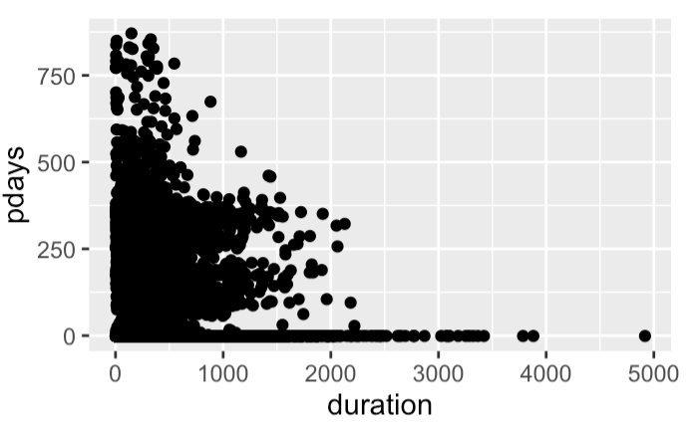
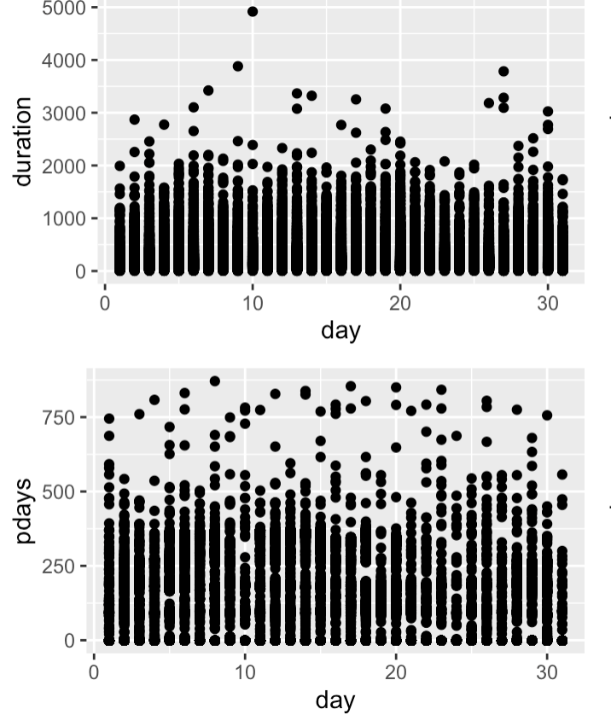
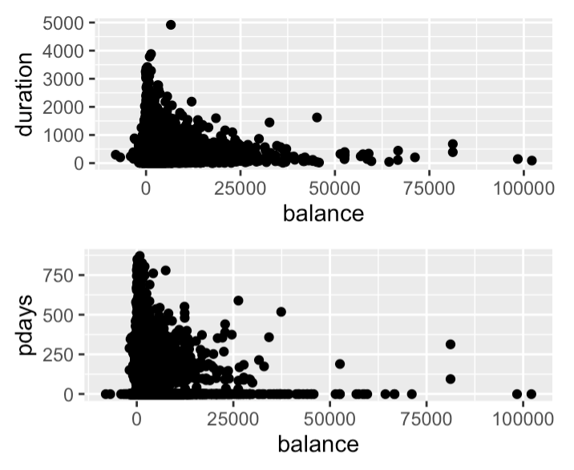
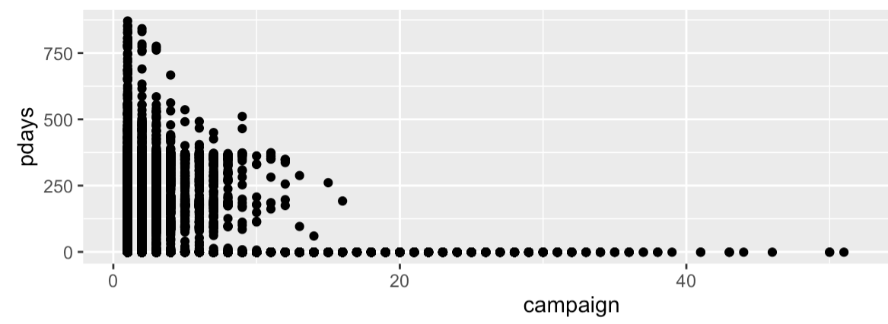
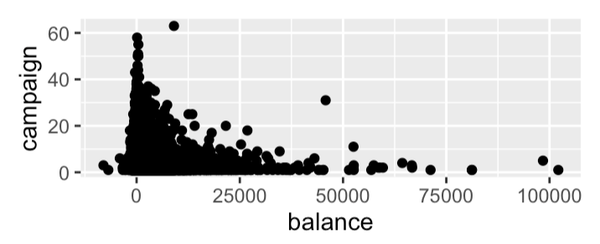
Measure/Measure
duration
day
balance
campaign
No linear relationship among most numeric attributes.

Slide 13
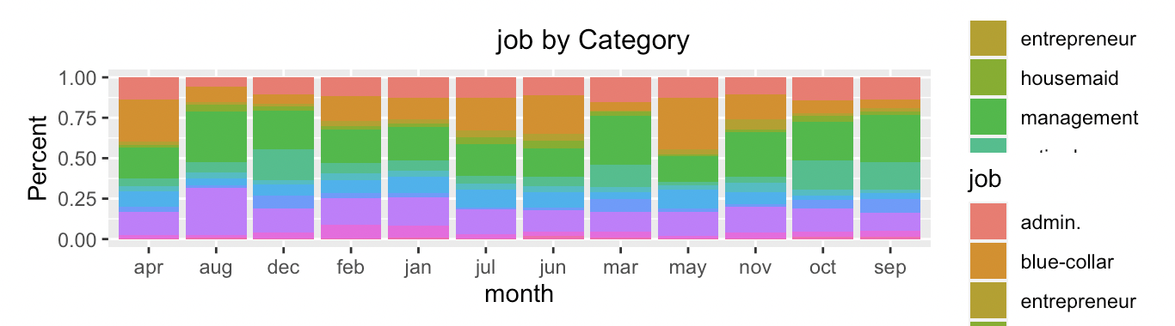
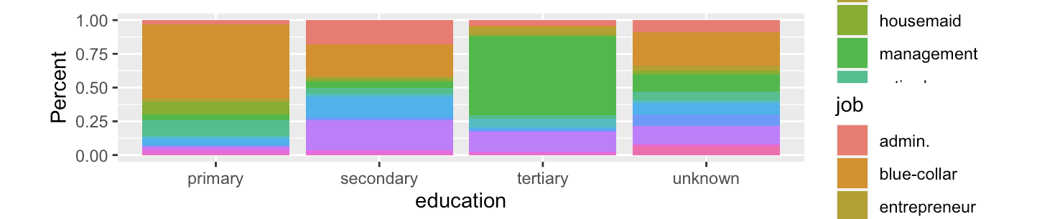
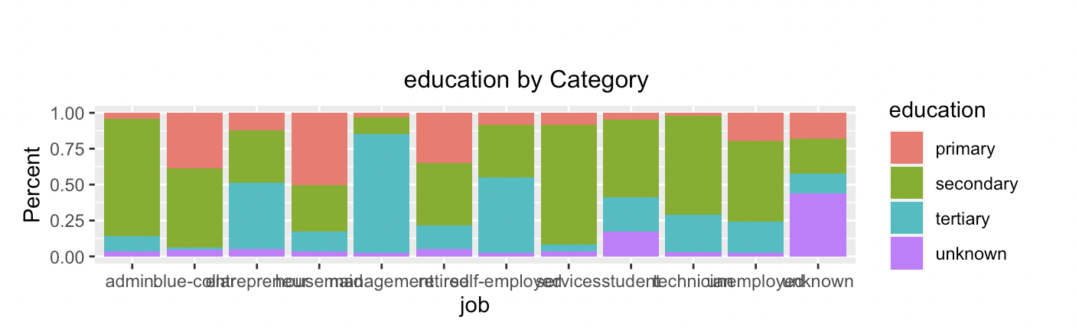
Category/Category
Last contact month of year is correlated to the client’s job.
Job management accounts for the large proportions in each month.
Job is impacted by the level of the education.
Job by Category
Education by Category
There is a relationship between job and education.
No apparent relationship or unexpected observation between other categories for the category distribution.

Slide 14
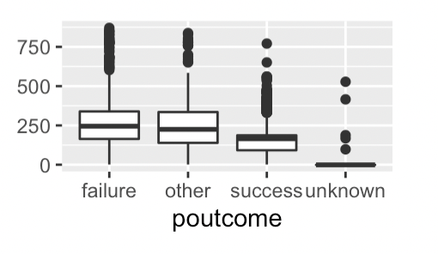
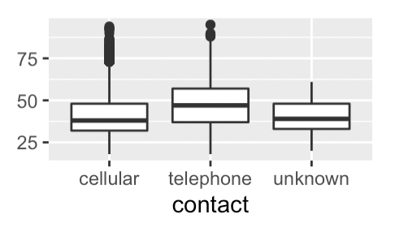
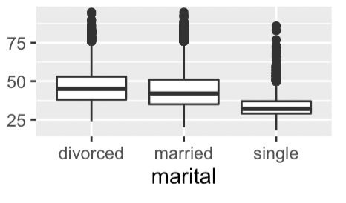
Category/Measure
pdays by category
While looking at measure distribution by different category values, nothing too surprising or unexpected observation for this dataset.
When the client outcome of previous marketing campaign is success, the number of days that passed by after the client was last contacted tend to be smaller than failure and other clients.
age by category
Some correlation between age and contact method, marital status.

Slide 15
4
PART FOUR
Modeling

Slide 16

Modeling Choose
Random Forest
Boosting
Decision Tree
Logistic Regression

Slide 17
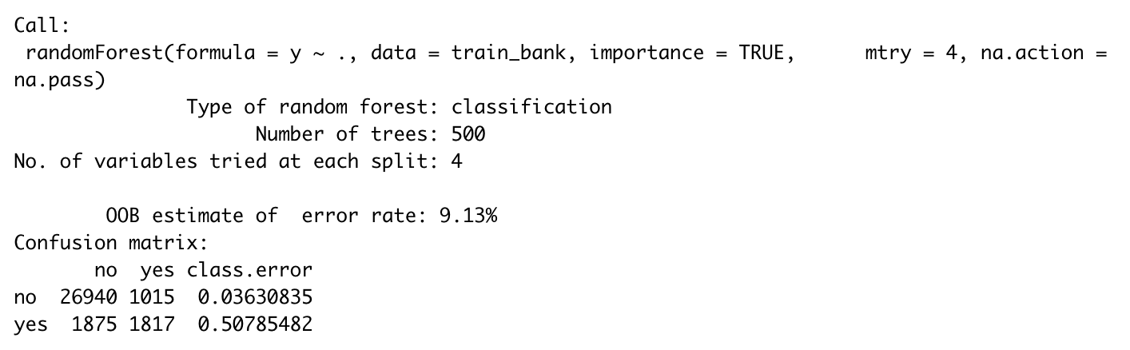
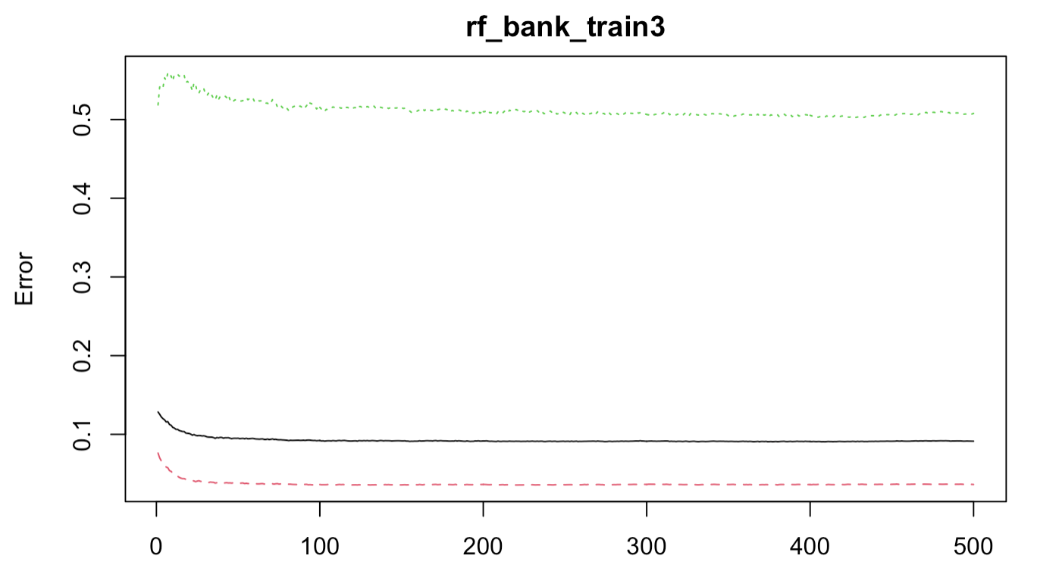
Random Forest
We splits 70% of the data selected randomly into training set and the remaining 30% sample into test data set.
We use a loop to find the best 'mtry' (Number of variables available for splitting at each tree node), which is 4, with the lowest out of bag estimate of error rate: 9.13%.
1
2
Plotting error rates based on different trees

Slide 18
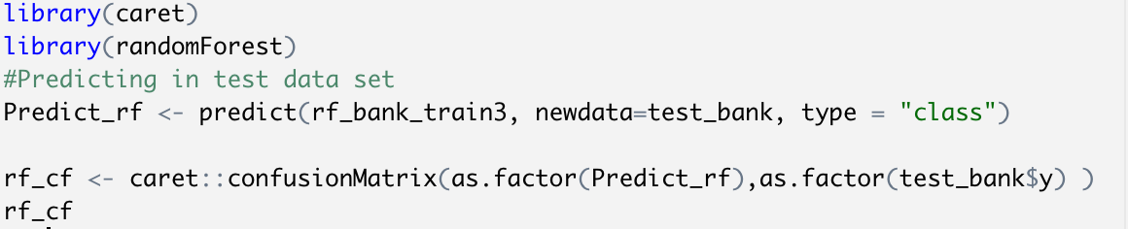
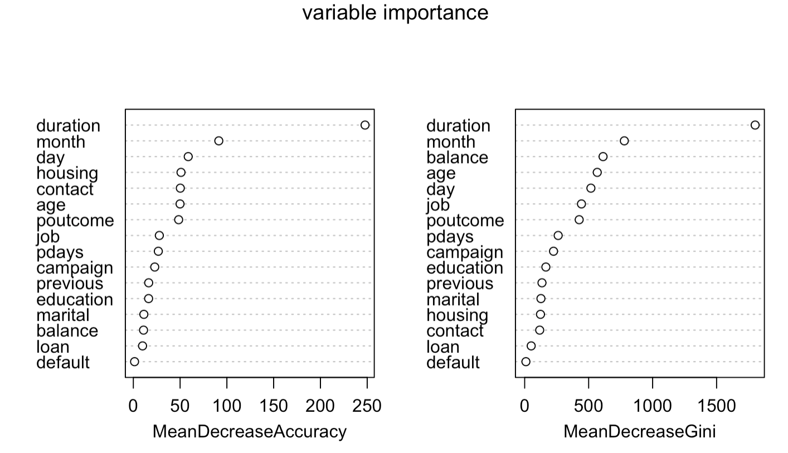
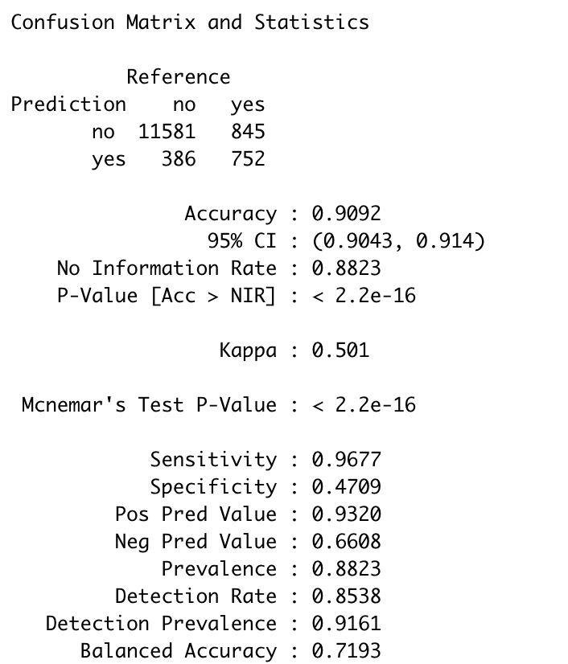
Random Forest
Duration is the most important factor. The longer contact duration lasts, the higher probability that the client would subscribe the term deposit.
Month and day are also important factors.
The model test accuracy is 90.92%, which seems a good classification model for the prediction.
The Kappa is 0.501, which shows good consistency.

Slide 19
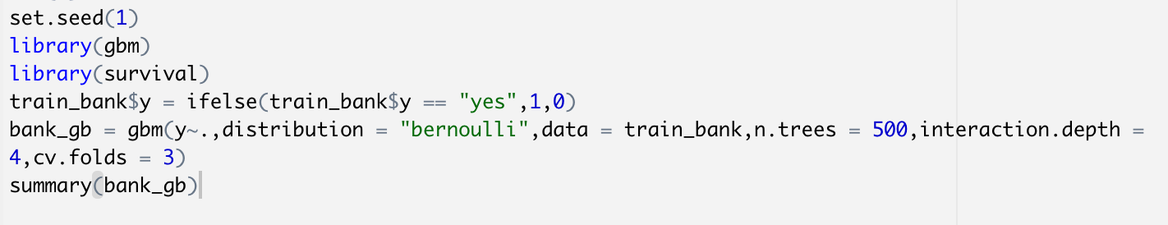
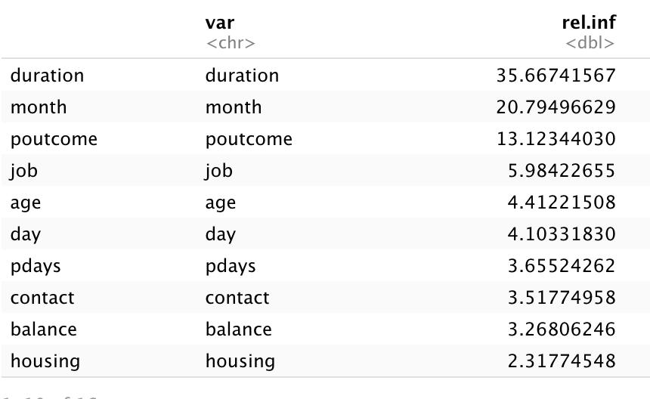
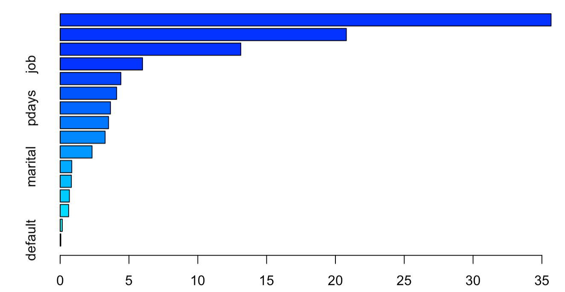
Boosting
We use gradient boosting to display the relative influence plot and the relative influence statistics.
From the plot, we can also conclude that duration, month and poutcome are three most important variables among all the predictors.

Slide 20
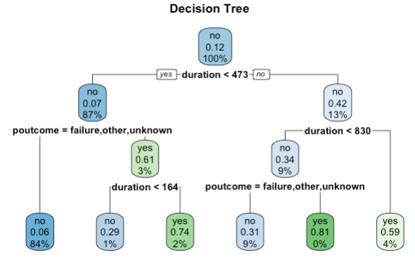
Decision Tree
The misclassification error rate is 10.95%, which implied this model is quite accurate.
Duration is the most important factor.
If the duration is greater than 830 then the customer would have a higher possibility to subscribe the term deposit.
1
Poutcome is also a significant factor. If the customer has subscribed a term deposit in the last campaign. The customer may also subscribe a term deposit in this campaign.
2
Notes:
For the decision tree model, Duration is the most important factor.
If the duration is greater than 830 then the customer would have a higher possibility to subscribe the term deposit. More over the poutcome is also an important factor, if the contact duration is not long enough, but the customer has subscribed a term deposit before. The customer would have a high possibility to subscribe a term deposit in this campaign.

Slide 21
Decision Tree
Confusion Matrix
Use 70% of the data to train the model and rest of 30% to test the model.
The error rate for the test data is 9.84%
 | No | Yes
No | 11706 | 1013
Yes | 321 | 523

Slide 22
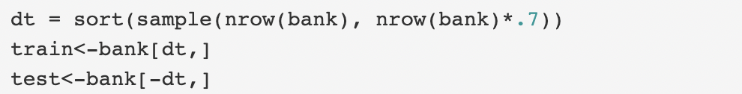
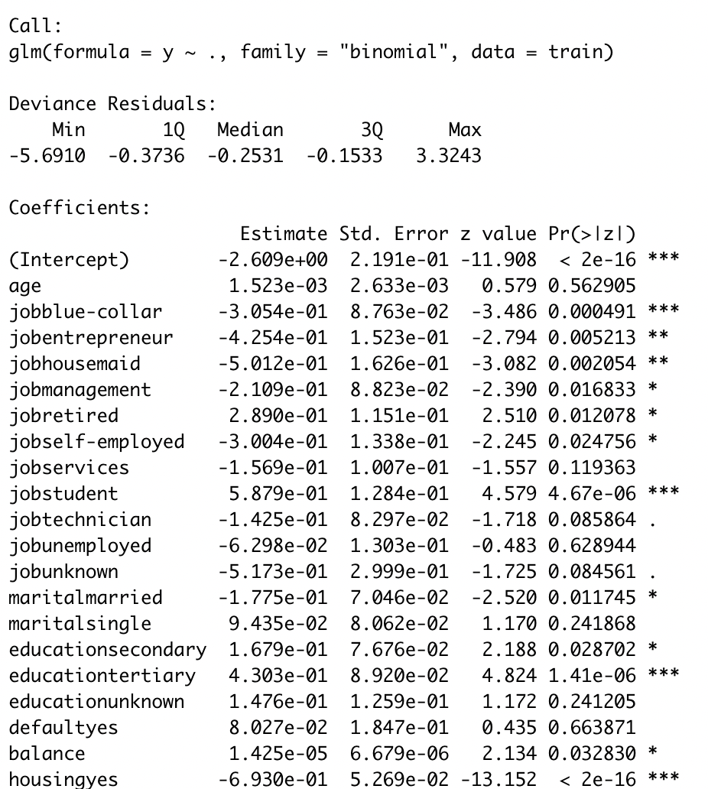
Logistic Regression
Firstly, split 70% of the data selected randomly into training dataset and the remaining 30% into test dataset .
Create a Logistic Regression Model
By looking at the p-value, we found duration, month, day, high education and campaigns, these are the attributes that highly significant in this model. On the other hand, attributes like age, pdays and previous are not statistically significant at level 0.05.

Slide 23
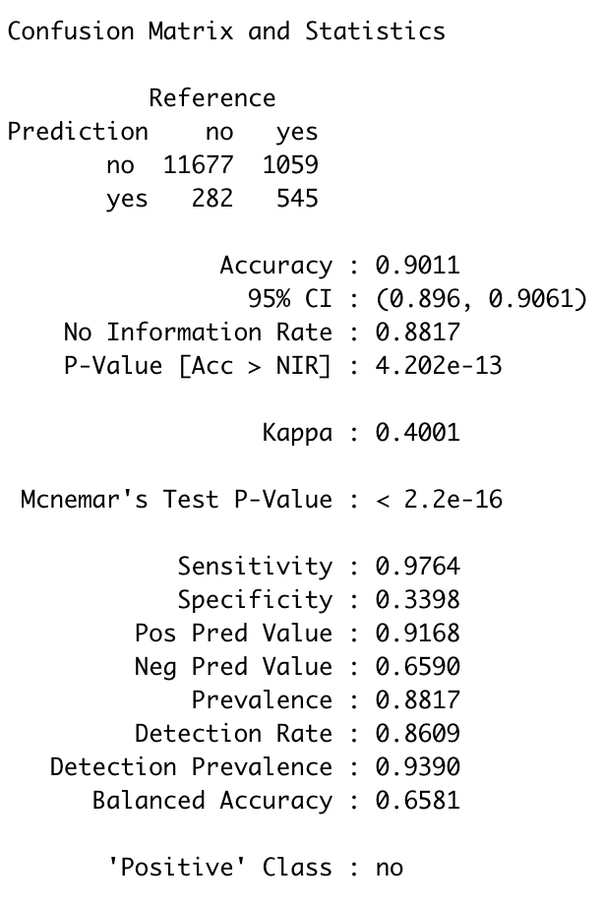
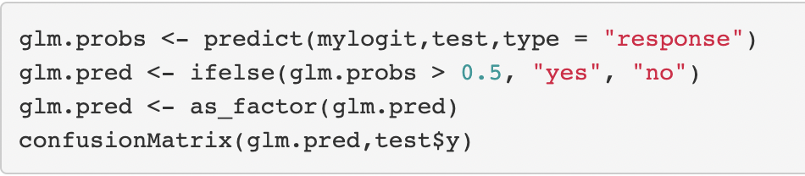
Logistic Regression
Set threshold = 0.5
Confusion Matrix
The accuracy rate for threshold = 0.5 is 90.11%.

Slide 24
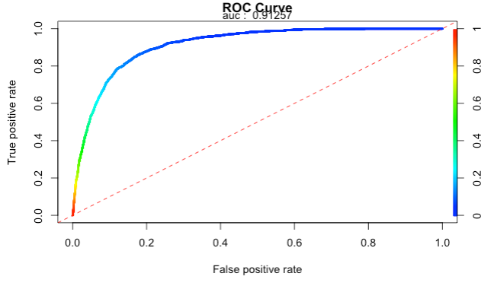
Logistic Regression
0.09 is the optimal threshold

Slide 25
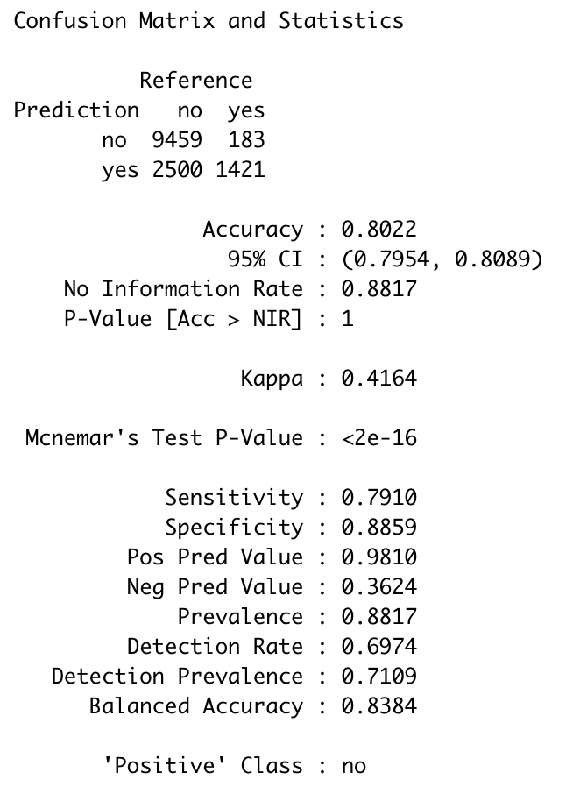
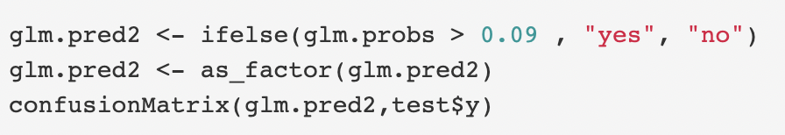
Logistic Regression
Set threshold = 0.09 (optimal threshold)
Confusion Matrix
The accuracy rate for threshold = 0.09 is 80.22%.

Slide 26
Logistic Regression
Comparing these two matrices, we can observe that when true positives increases, the true negative decreases.
Trade Off:
Since we aim to find out the effectiveness of market campaigns and target customers, we want to maximize the true positive, which is the customer truly say yes. So we choose 0.09 as our threshold.
Threshold = 0.5
 | No | Yes
No | 11677 | 1061
Yes | 280 | 546
Threshold = 0.09
 | No | Yes
No | 9435 | 182
Yes | 2522 | 1425

Slide 27
5
PART FIVE
Summary
and
Conclusions

Slide 28
Summary
All our models have high predictive power as indicated by duration which is the last contact duration with the costumers.
We can also conclude and suggest that company to focus on their previous customer who have subscribed a term deposit in the previous campaign. Ideal target customer is in the mid-age with higher education. We also recommend keeping the contact duration as long as possible.
From the logistic regression, we find out that higher education, longer contact duration seem to be predictive and positively correlated with the subscription yes. And 0.09 is a ideal cut-off point for this business problem.
From the random forest and boosting model, we can see when the outcome of the previous marketing campaign is successful, the last contact month of year gets closer and the duration lasts longer, the client is more likely to subscribe the term deposit.
Our decision tree models suggests that if the contact duration is higher than 830 seconds, then there will be a higher possibility that the customer would subscribe the term deposit.

Slide 29
////////////////////////////
Thanks for Your Time
////////////////////////////

